Slide 1

IN THE NAME OF GOD

Slide 2
OBSTETRICS REFRESHER

Slide 3
Pregnancy, Childbirth, Puerperium

Slide 4
Pregnancy
Pregnancy is a normal, temporary condition occurs within the female body, which begins at the time of conception (fertilization of the female ova by the male sperm) and ends with the birth of the fetus.

Slide 5
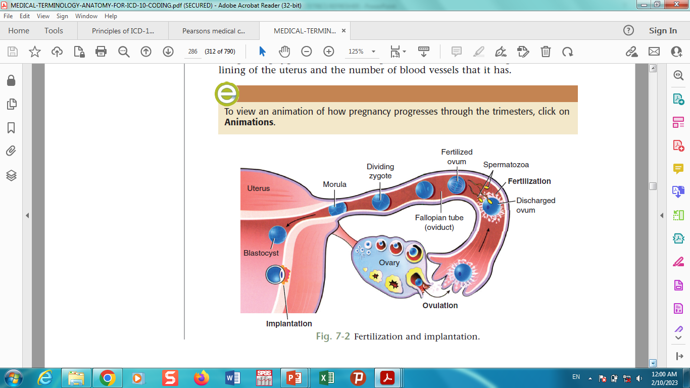
Pregnancy

Slide 6
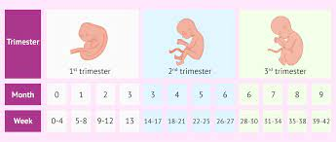
Pregnancy

Slide 7
Pregnancy
The term (length) of a normal pregnancy is 38–40 weeks.
The estimated date of delivery (EDD) is determined as 40 weeks from the last menstrual period (LMP).
Estimated gestational age (EGA) is the number of weeks and days since the LMP.
The pregnancy is divided into three trimesters, defined based on gestational age as follows:
• First trimester—Less than 14 weeks, 0 days
• Second trimester—14 weeks, 0 days to less than 28 weeks, 0 days
• Third trimester—28 weeks, 0 days until delivery

Slide 8
Pregnancy length
Pre-term
Less than 37 completed weeks (less than 259 days) of gestation
Term
From 37 completed weeks to less than 42 completed weeks (259 to 293 days) of gestation
Post-term
42 completed weeks or more (294 days or more) of gestation

Slide 9
Prenatal, prepartum, antepartum, or antenatal
The prenatal period is the time period from conception to the beginning of labor.
It is also called the prepartum, antepartum, or antenatal period.

Slide 10
Childbirth
Childbirth, also called parturition, is the period of true labor and active delivery
(uterine contractions and dilation of the cervix) and (the expulsion of the fetus and placenta from the uterus).

Slide 11
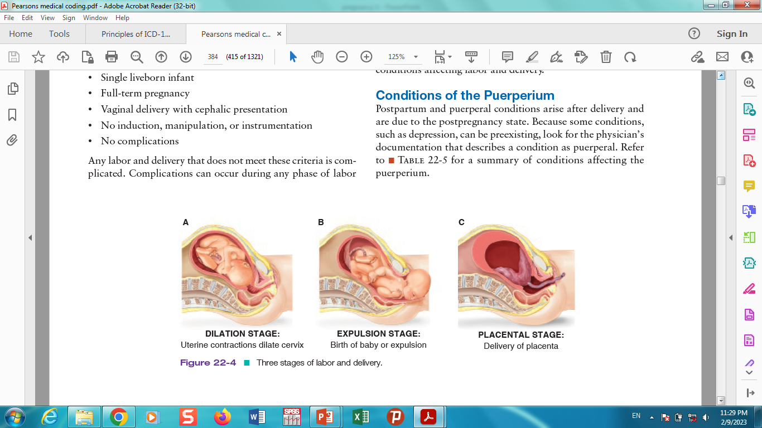
Childbirth stages

Slide 12
puerperium
The puerperium, puerperal period, or postpartum period is the six-week period following childbirth.
During which time the female reproductive organs return to the prepregnant state.
The peripartum period is the last month of pregnancy to five months postpartum.

Slide 13
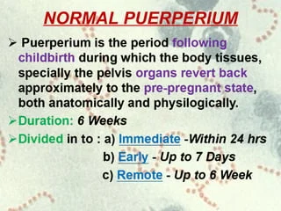
puerperium

Slide 14
gravida (G) and para (P)
A woman’s childbearing history is described in terms of
gravida (G) (the number of pregnancies) and para (P) (the number
of pregnancies resulting in a fetus of viable gestational age
[20 weeks] regardless of whether the fetus was alive at birth).

Slide 15
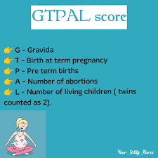
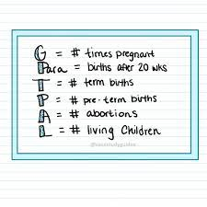
gravida (G) and para (P)

Slide 16
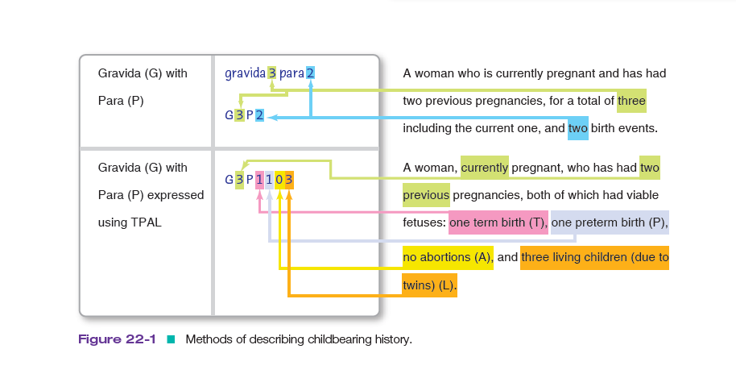
gravida (G) and para (P)

Slide 17
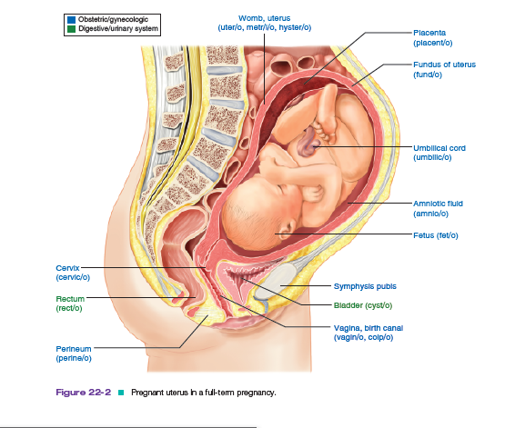
structure in the pregnant uterus

Slide 18
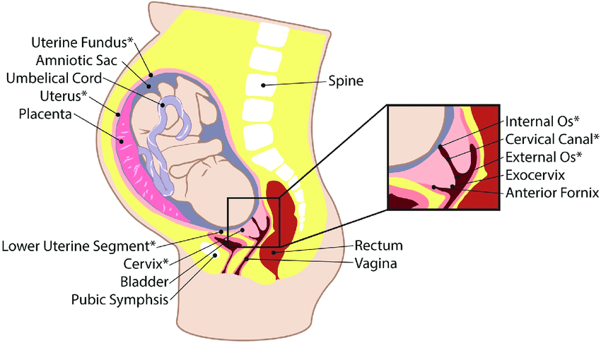
structure in the pregnant uterus

Slide 19
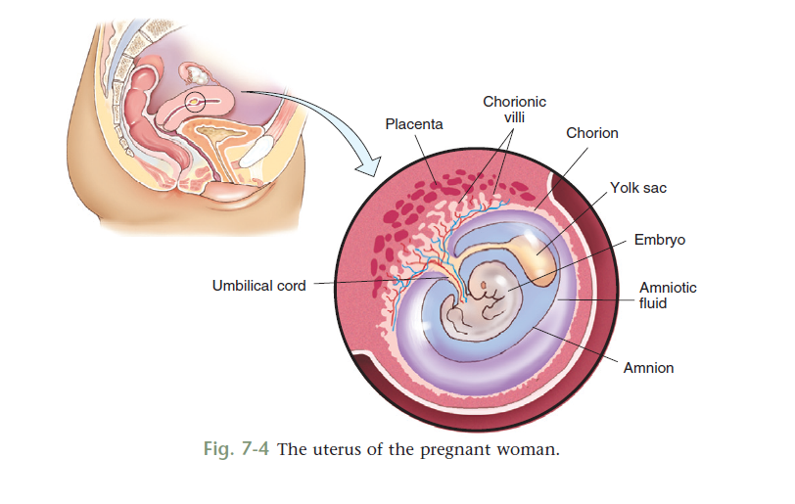
structure in the pregnant uterus

Slide 20
A normal pregnancy
A normal pregnancy is defined as follows:
• No preexisting conditions
• No new conditions that develop during pregnancy
• Single gestation
• Mother will be over age 16 and under age 35 at EDD

Slide 21
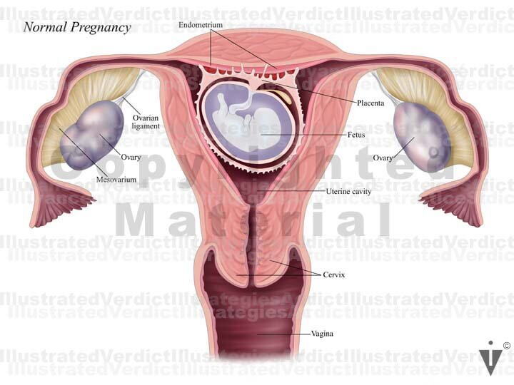
A normal pregnancy

Slide 22
A normal delivery
A normal delivery is defined as follows:
• Single liveborn infant
• Full-term pregnancy
• Vaginal delivery with cephalic presentation
• No induction, manipulation, or instrumentation
• No complications

Slide 23
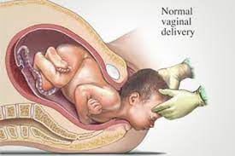
A normal delivery

Slide 24
the Apgar score
Although newborn weights are one indicator of the state of the health of a newborn, the Apgar score rates the physical health of the infant with a set of criteria 1 minute and 5 minutes after birth. The five criteria are conveniently summarized as Appearance, Pulse, Grimace, Activity, Respiration.
This scoring system provided a standardized assessment for infants after delivery. The Apgar score comprises five components: 1) color, 2) heart rate, 3) reflexes, 4) muscle tone, and 5) respiration, each of which is given a score of 0, 1, or 2.

Slide 25
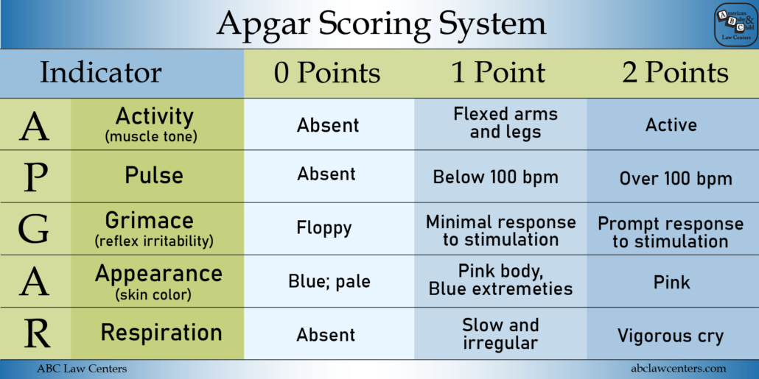
the Apgar score

Slide 26
Conditions Due to Pregnancy
Compared to
Preexisting Conditions

Slide 27
Preexisting Conditions
When a condition has been diagnosed before a woman becomes pregnant, it is a preexisting condition.

Slide 28
Gestational condition / pregnancy induced
When the condition is first diagnosed during pregnancy, it is a gestational condition.

Slide 29
Characteristics of a gestational condition
The gestational disease has the same symptoms and signs as its nongestational counterpart.
The condition is not present prior to pregnancy.
The condition usually begins after the 20th week of pregnancy.
The condition returns to normal when the pregnancy is over.
such as gestational diabetes or gestational hypertension

Slide 31
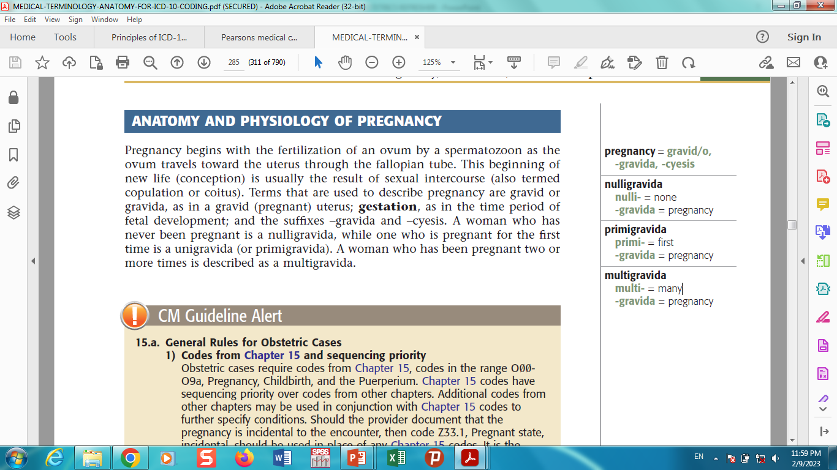

Slide 32
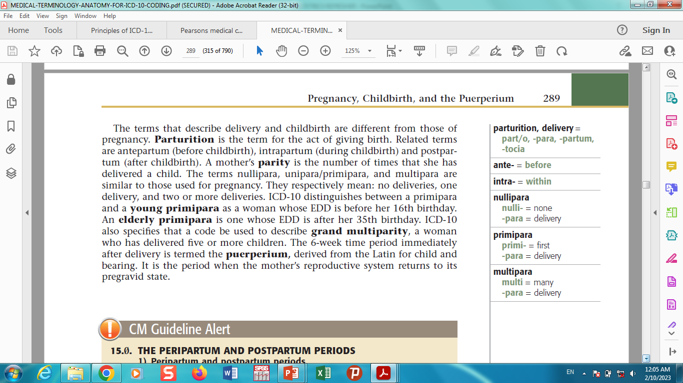

Slide 33
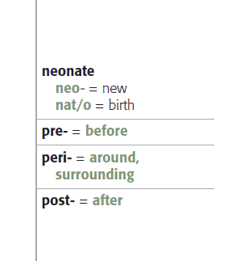

Slide 34
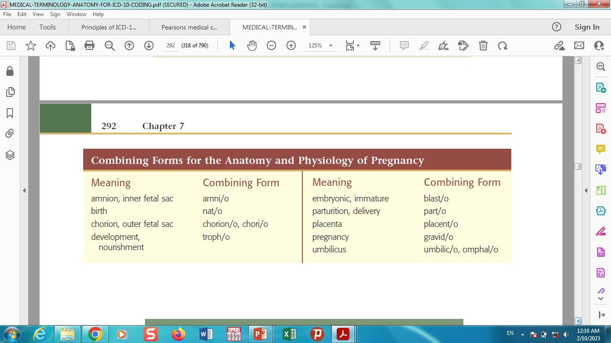

Slide 35
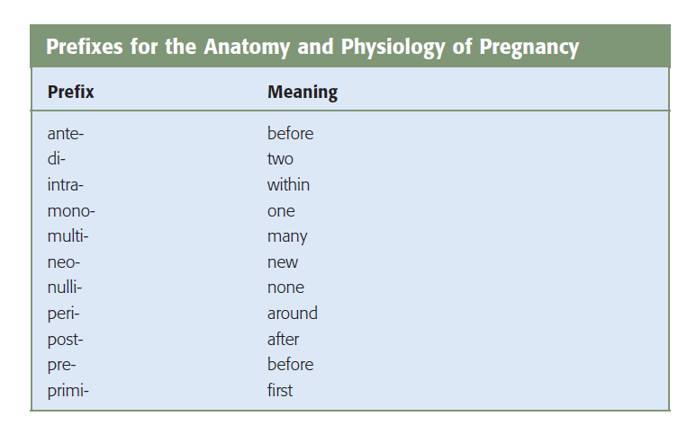

Slide 36
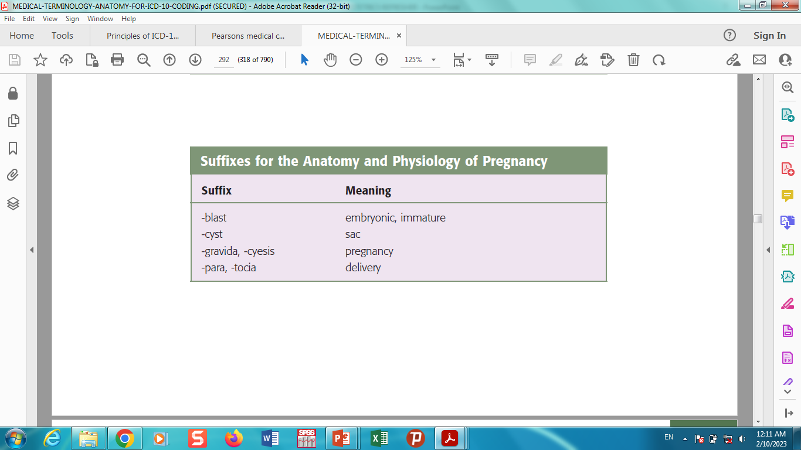

Slide 37
THE END
THANKS

